Slide 1
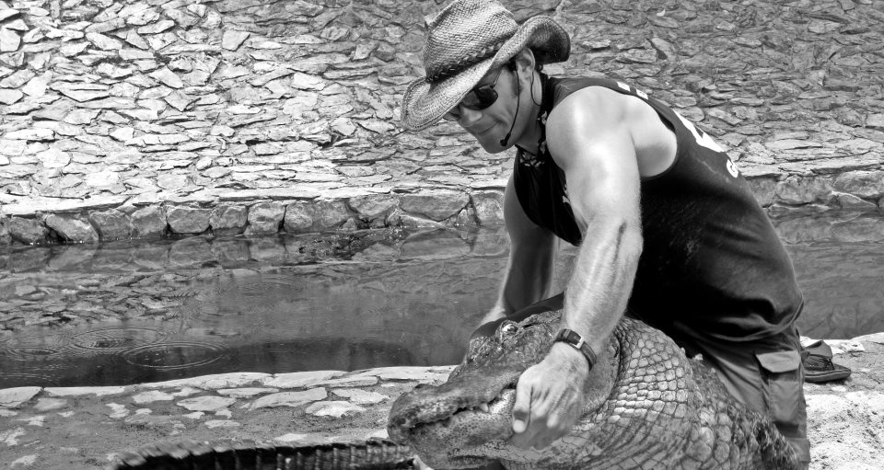
Your Brain Is Broken
… and you suck at making decisions

Slide 3
Brains: perfect thinking machines?
Negativity Bias
Bandwagon Effect
Hyperbolic Discounting
Confirmation Bias
Choice-supportive bias
Normalcy Bias
Pro-innovation Bias
Endowment Effect
Barnum Effect
Hindsight Bias
Clustering Illusion
Availability Heuristic
Sunk Cost Fallacy
Neglect of Probability
Omission Bias
Framing Effect
Anchoring
Conservatism
Bias Blind Spot
Law of the Instrument
Expectation Bias
Planning Fallacy
Information Bias
Cheerleader Effect
Backfire Effect
Contrast Effect
Ostrich Effect
Gambler’s Fallacy
Rhyme as Reason Effect
Base Rate Fallacy
Hostile Attribution Bias
Hot-hand fallacy
Berkson’s Paradox
Pareidolia
Denomination Effect
Illusory Correlation
Distinction Bias
Post-Purchase Rationalization
Curse of Knowledge
Functional Fixedness
Loss Aversion
Frequency Illusion

Slide 4
Brains: perfect thinking machines?
Confirmation Bias – the tendency to seek out information that conforms to our already held beliefs
Sunk Cost Fallacy – the tendency to continue with an activity even if it has a very small chance of success because of invested resources
Framing Effect – the tendency to react to a particular choice differently depending on how it is presented
Availability Heuristic – the tendency to view information that is easily recalled as more important than alternatives
Bias Blind Spot – the tendency to see these biases in others, but not in ourselves

Slide 5
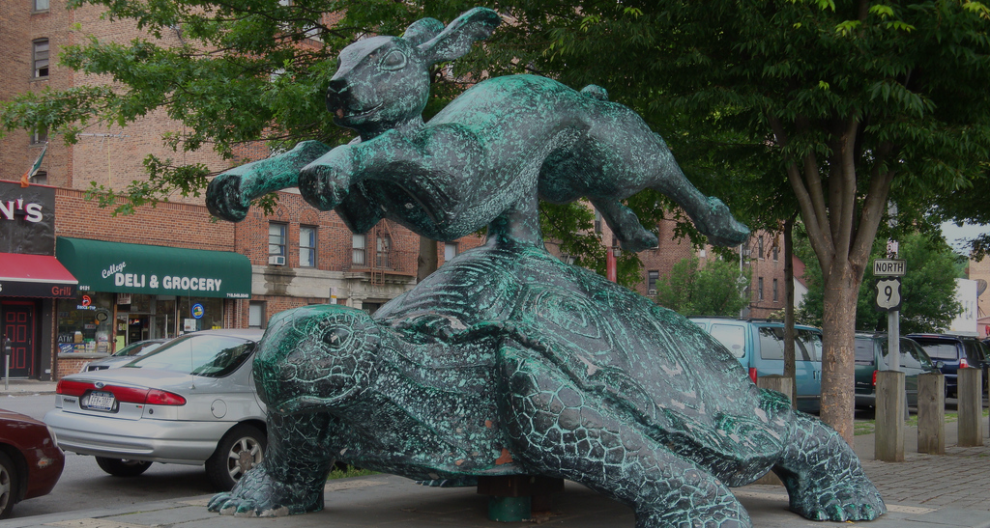
Fast vs. slow thinking

Slide 6
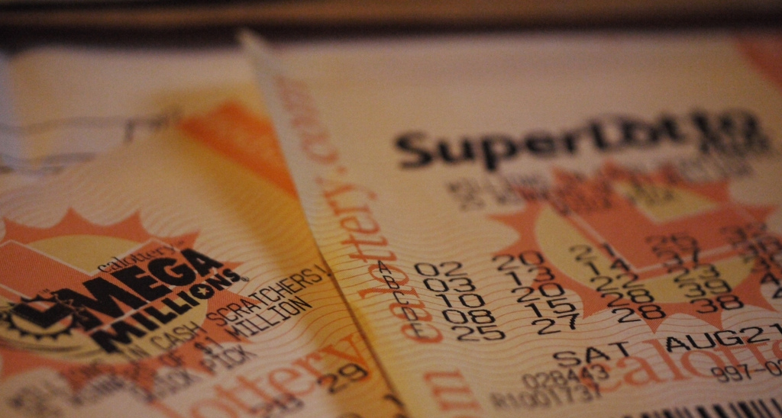
We’re bad at understanding probability

Slide 7
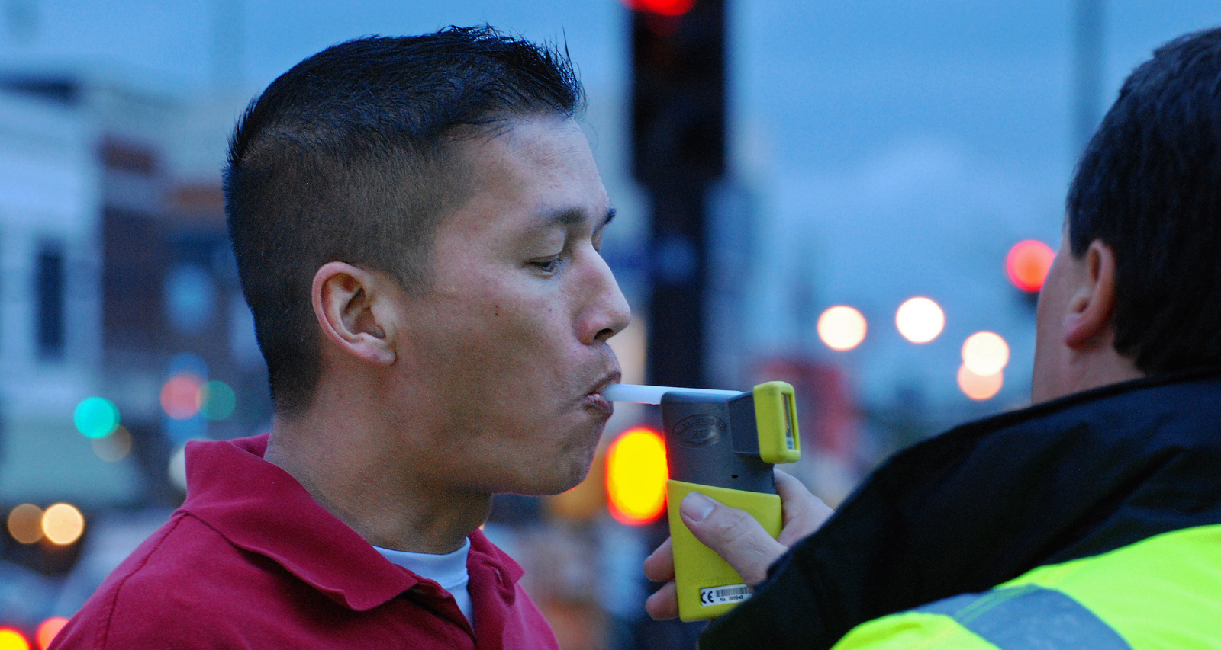
Probability – A quick mental exercise
New breathalyzers
The local police buy new breathalyzers for the department.
If someone is intoxicated it will indicate it 100% of the time (no false negatives).
If someone is not intoxicated it will indicate a positive (a false positive) 5% of the time.
Statistics have shown that at any given time, an average of 1 out of every 1000 motorists are intoxicated.
Police pull over a motorist completely at random. When asked to blow into the breathalyzer, the test shows that the person is intoxicated.
What is the probability that the person is intoxicated?
Let’s vote
Should this person get a ticket for DUI?
YES
NO

Slide 8
Our vision is broken

Slide 12
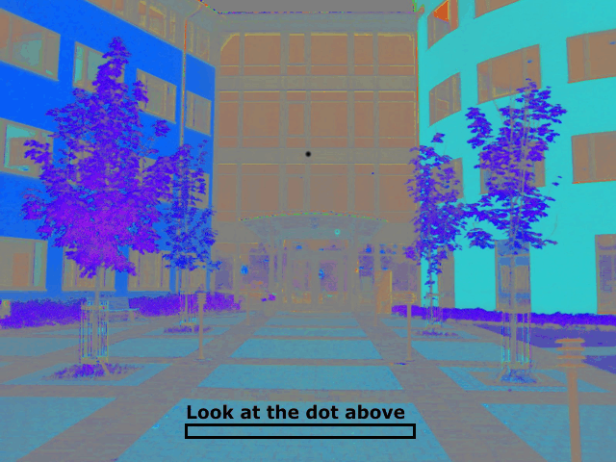

Slide 13
Our memory is broken

Slide 14
How agile practices buffer us from ourselves

Slide 15
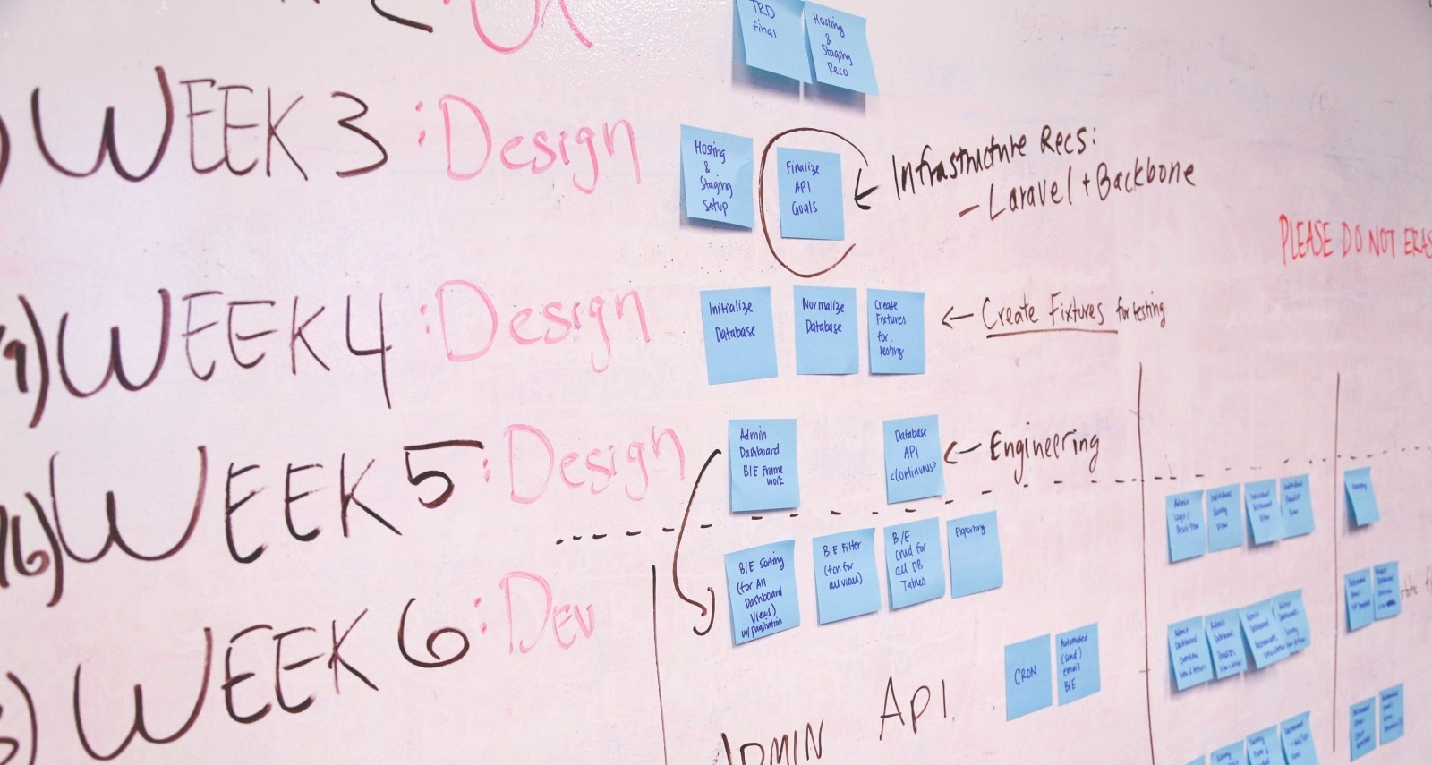
Planning practices – overcoming the Planning Fallacy

Slide 16
Avoiding conformity effects

Slide 17
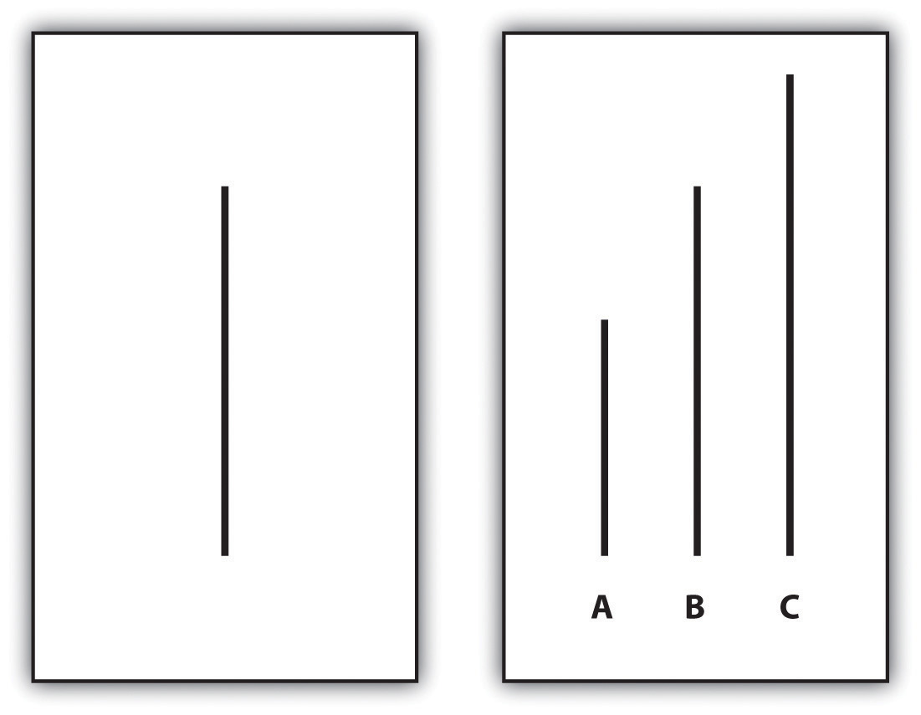
The Asch experiment
74% of people conformed at least once
On average, people conformed about 1/3 of the time
Only around three opponents is required for people to conform at these levels

Slide 18
Feedback practices

Slide 19
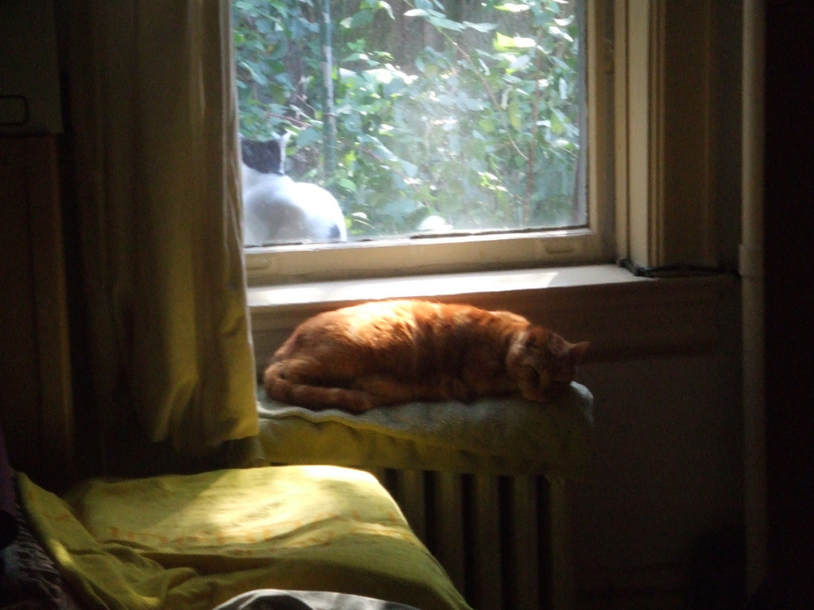
Hijacking the Availability Heuristic using Information Radiators
Image needed

Slide 20
Breaking the Curse of Knowledge by telling effective User Stories

Slide 21
Thank you! See you soon?
Nate Adams
Web: newbo.co
E-mail: nate@newbo.co
Everything else: @psiberknetic
Product Owner Fundamentals Workshop is the morning of October 26th. Learn how to manage your backlog, break stories into manageable chunks and practice prioritization technoques.
NewBoCo is partnering with Jason Tanner of Applied Frameworks to bring two Certified Scrum Trainings to Iowa.
Certified ScrumMaster + Innovation Games® is November 13-14. You will become a Certified ScrumMaster® once you pass the CSM test and receive Education Credits towards your Certified Scrum Professional (CSP) designation.
Certified Scrum Product Owner (CSPO) + Innovation Games® is November 15-16

