Slide 1
Useful, Usable & Desirable
Creating products that make a difference.
Andy Van Fleet - Partner
CREATE A MEANINGFUL EXPERIENCE

Slide 3
Notes:
The Law of Conservation of Complexity – states that every application has an inherent amount of irreducible complexity. This complexity cannot be wished away and has to be dealt with, either in product development or in user interaction. It’s a teeter totter of where this complexity falls.

Slide 4
Business Constraints
Notes:
The Law of Conservation of Complexity – states that every application has an inherent amount of irreducible complexity. This complexity cannot be wished away and has to be dealt with, either in product development or in user interaction. It’s a teeter totter of where this complexity falls.

Slide 5
Useful / Usable / Desirable
(needed)
(understandable)
(wanted)

Slide 6
”In the first 30 seconds of any new product experience,
expect users to be lazy, vain and selfish.”
Scott Belsky – Angel Investor / Chief Product Officer, Adobe

Slide 7
Useful

Slide 8
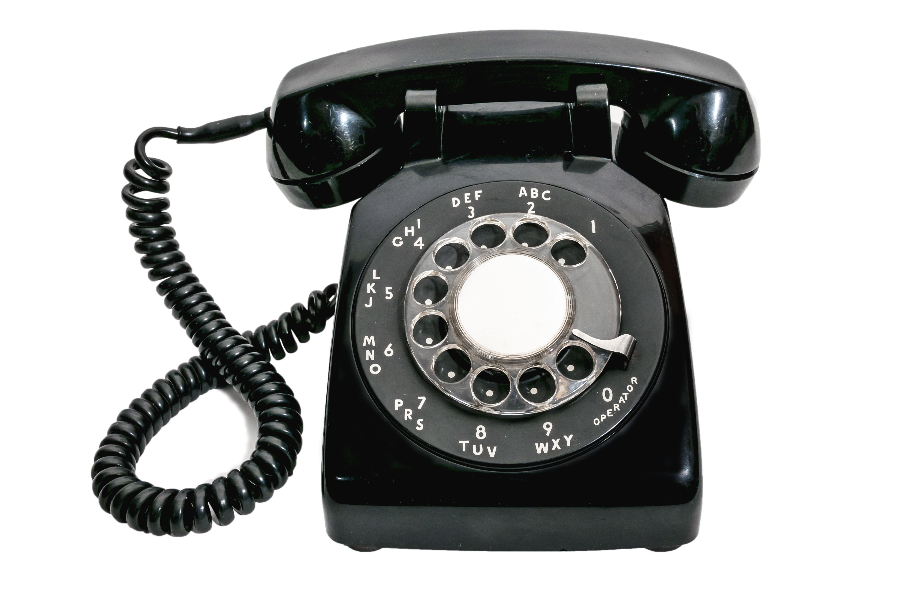

Slide 9
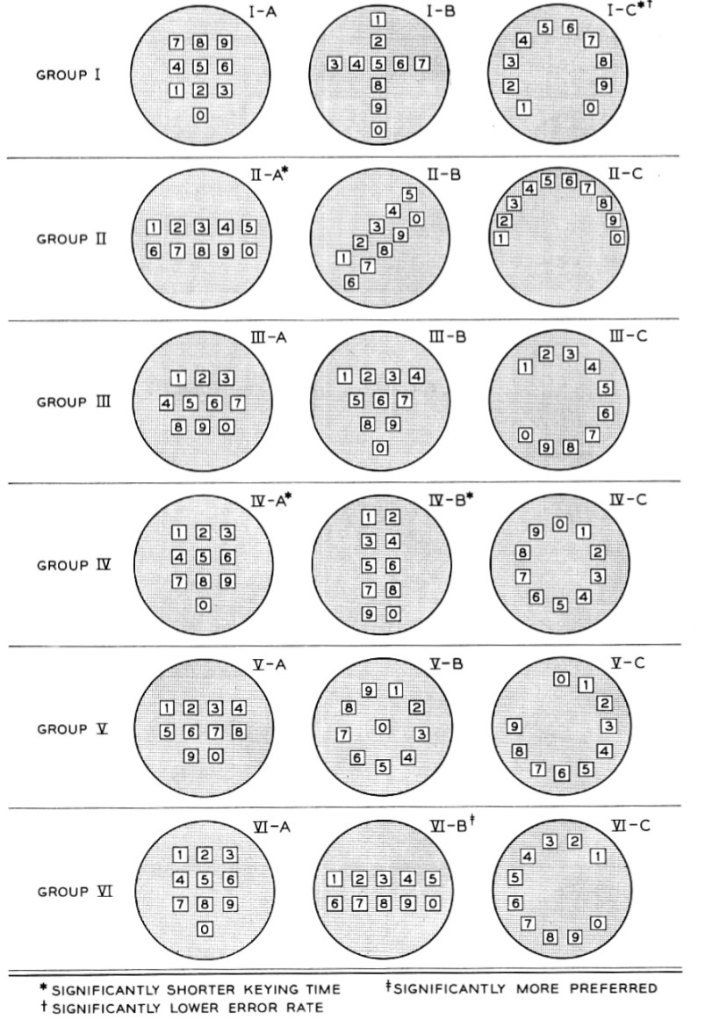
Bell Labs Study
18 Keypad Configurations
Keying Time (Useful)
Prevent Errors (Usable)
Preference (Desirable)

Slide 10
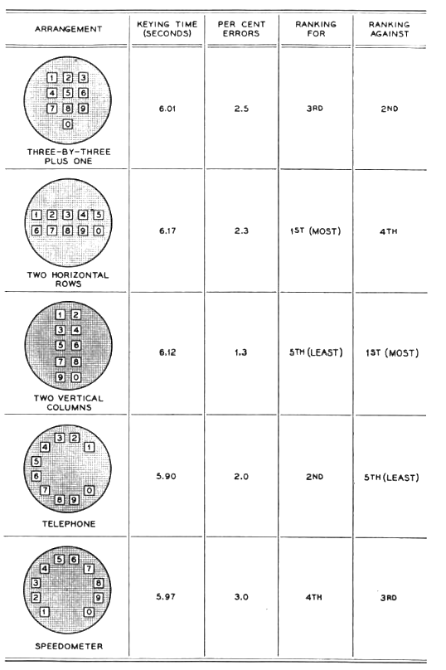
Bell Labs Study
Down-selected to 5 Keypads
Keying Time (Useful)
“I need to call someone.”
Prevent Errors (Usable)
“I understand how to use the keypad.
Preference (Desirable)
“I want to use this keypad configuration.”
Most
Liked
Least
Errors
Dis-
Liked
Fastest

Slide 11
Bell Labs Study
Best options
Down Selection Process
Went from 5 options to 2
Disliked most
Too expensive
to manufacture

Slide 12
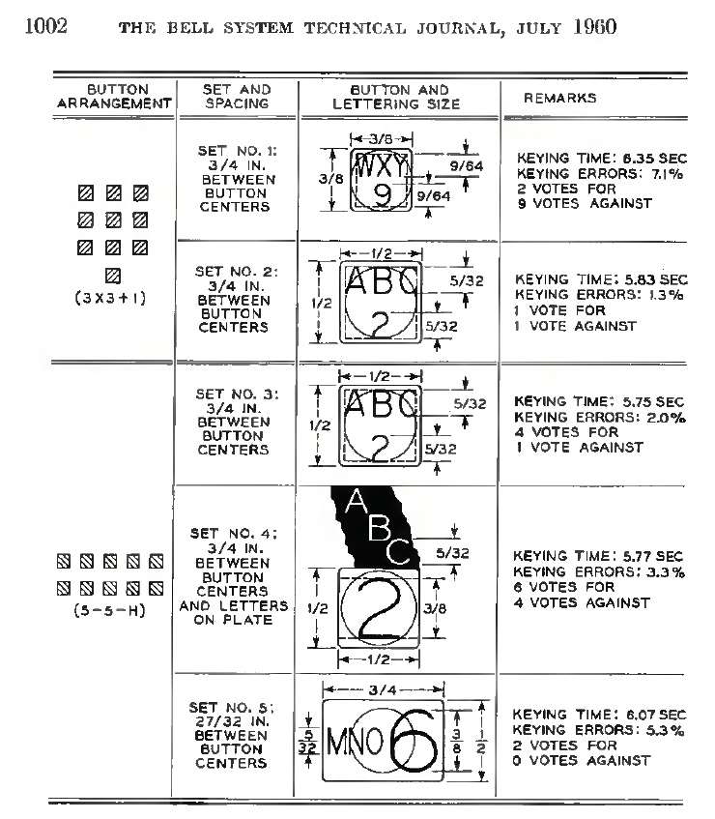
Bell Labs Study
Down Selected to 2 Preferred Keypads
3x3+1
5-5-H: Two Horizontal Rows
Looked at all factors;
User Input
Engineering Costs
Refactoring the button sizes
And ultimately went the the 3x3+1

Slide 13
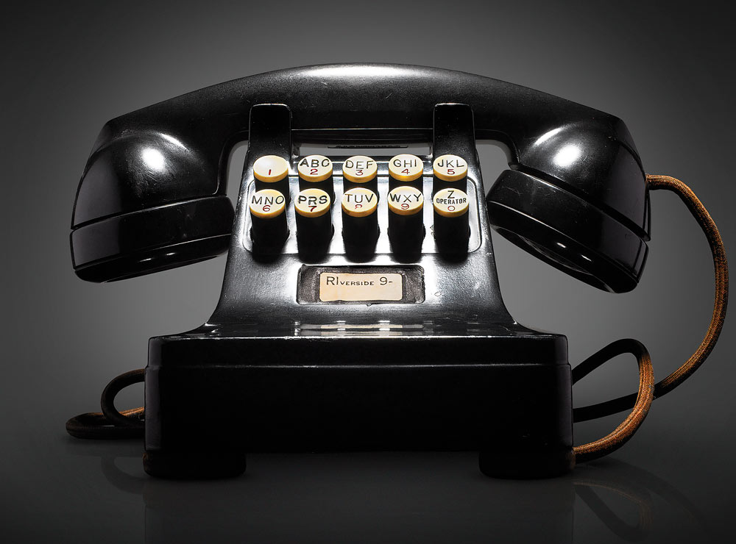
Favorite

Slide 14
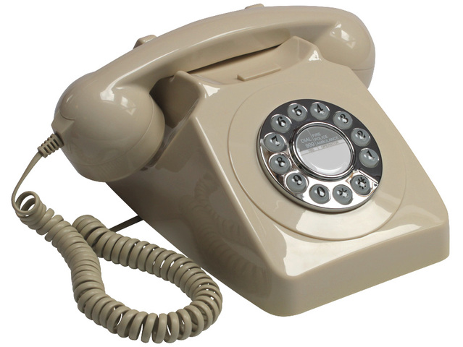
Fastest

Slide 15
Final Decision

Slide 16
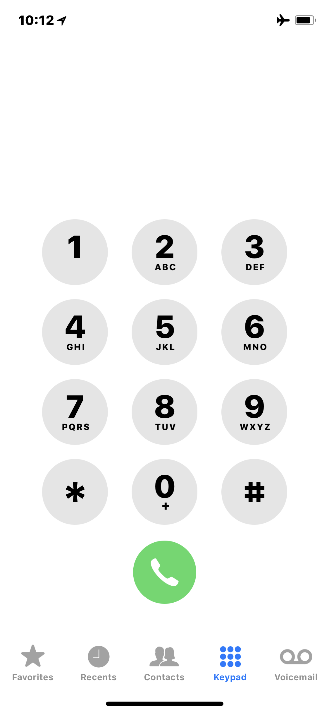
Today’s Touch Keypad is the Same as in 1960

Slide 17
It’s a Balancing Act
Business Constraints

Slide 18
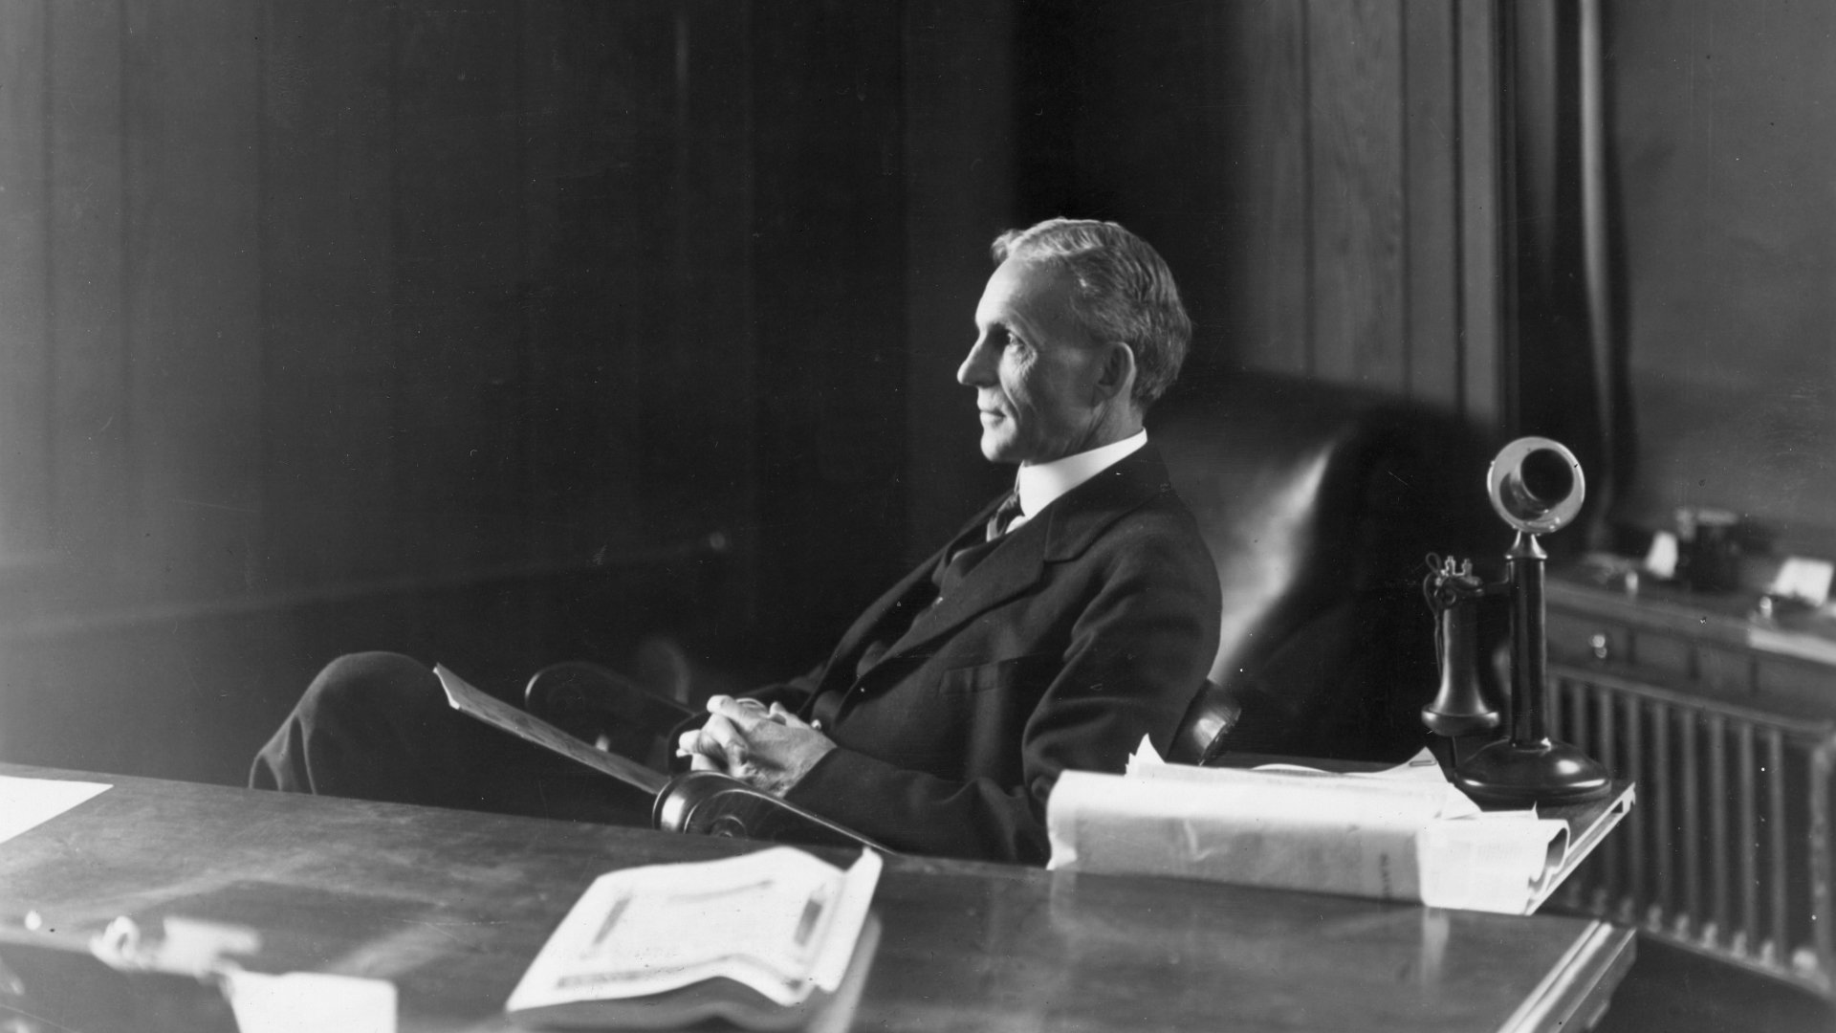
If I had asked people what they wanted, they would have said ‘faster horses.’
- Henry Ford

Slide 19
3 Take-Aways / Useful
Know how to listen to users, but be cautious of user bias.
Engineering has to build it, so they should have a strong voice in the product development process.
It takes time and patience to coordinate the delicate balance between engineering, users, and the business. But done correctly, the solution should have longevity.

Slide 20
Usable

Slide 21
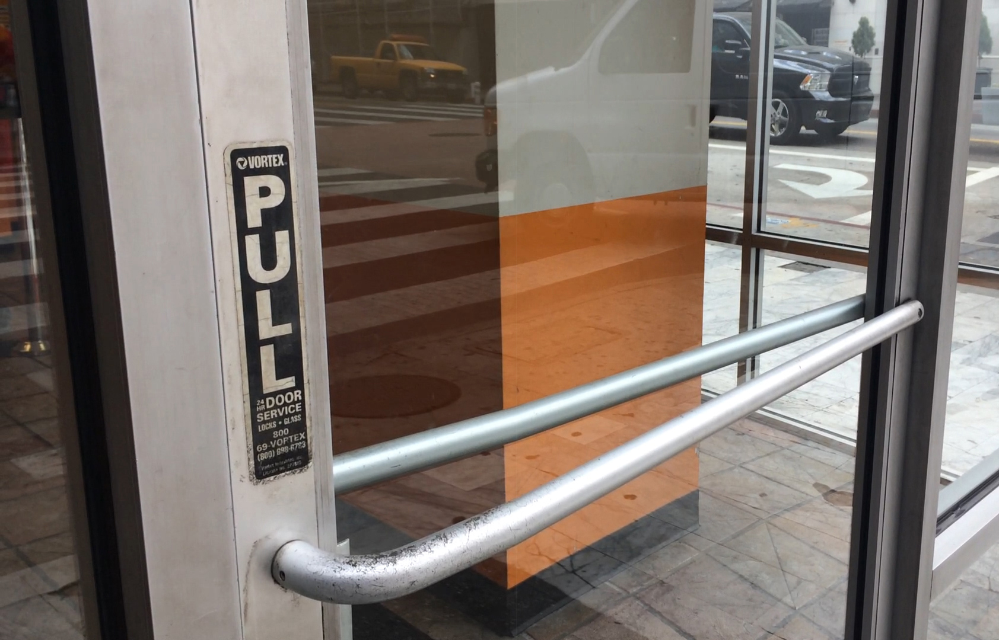
Notes:
If you have to explain, it’s not usable.

Slide 22
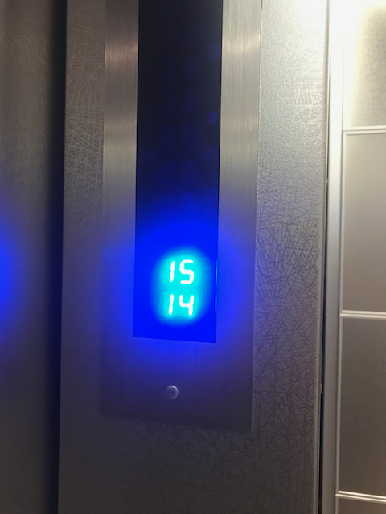
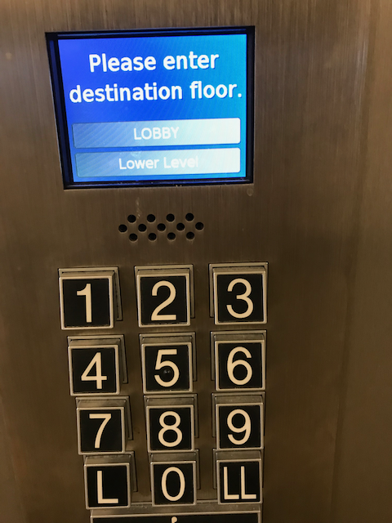

Slide 23
It’s worth noting that usability failures are often less catastrophic to a product than a failure to provide something useful.

Slide 24
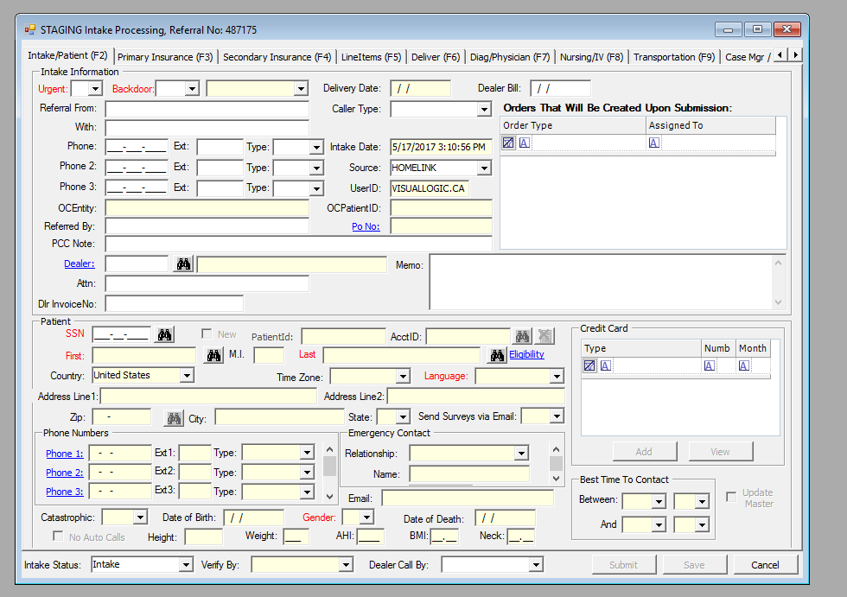
Notes:
It’s worth noting that usability failures are often less catastrophic to a product than a failure to provide something useful.

Slide 25
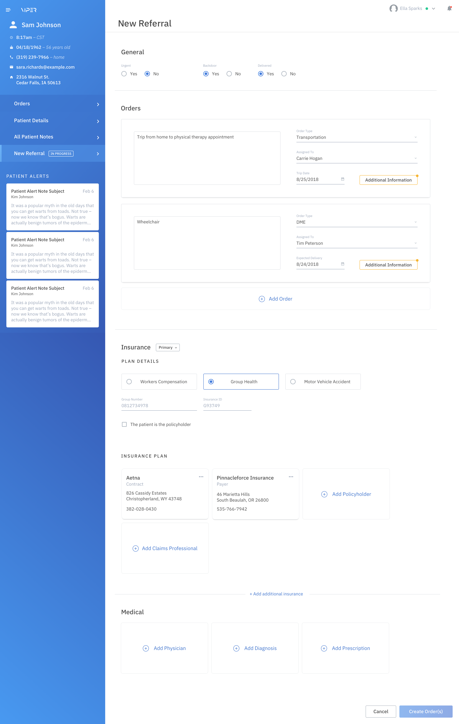
Notes:
It’s worth noting that usability failures are often less catastrophic to a product than a failure to provide something useful.

Slide 26
Getting to Simple is Hard.
Notes:
The length of time isn’t always generous either.

Slide 27
5 Core Usability Tenants
Learnability
Efficiency
Memorability
Errors
Satisfaction

Slide 28
3 Take-Aways / Usable
From a user’s perspective, the product should be designed so that the features and the intended use are obvious.
Usability failures are often less catastrophic to a product than a failure to provide something useful.
5 core usability tenants can help determine the usability of a product, and where improvements should be made.

Slide 29
Desirable

Slide 30
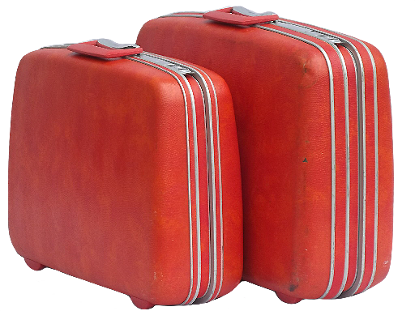

Slide 32
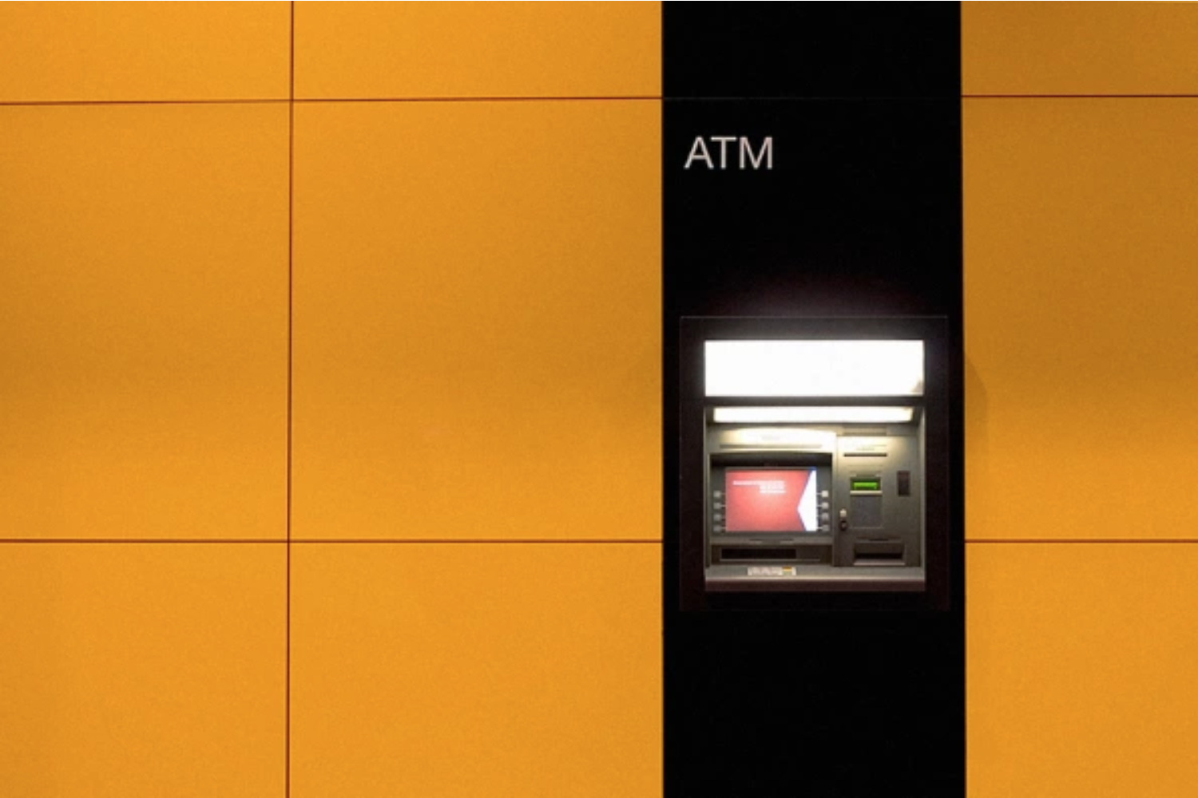
Users perceive more pleasing products as more usable. Researchers tested two ATMs that functioned identically. Testers cited the attractive ATM as actually working better, meaning a delightful design can, in a way, improve usability.
Notes:
Don Norman explains that when users are enjoying themselves, they’re more relaxed, and when the brain is relaxed, it functions better overall. This means learning new concepts, recalling past data, even motor skills occur more fluidly.

Slide 33
Don Norman explains that when users are enjoying themselves, they’re more relaxed, and when the brain is relaxed, it functions better overall.
This means learning new concepts, recalling past data, even motor skills occur more fluidly.

Slide 34
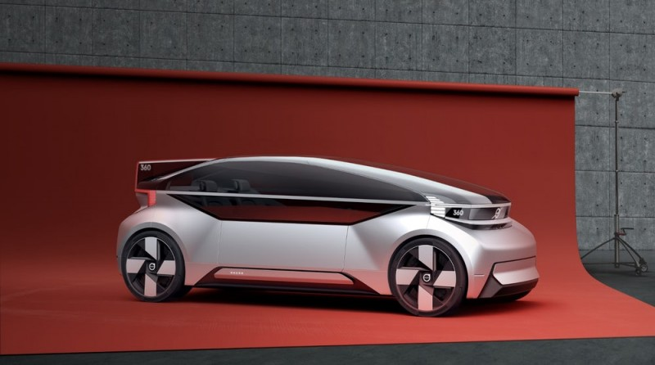
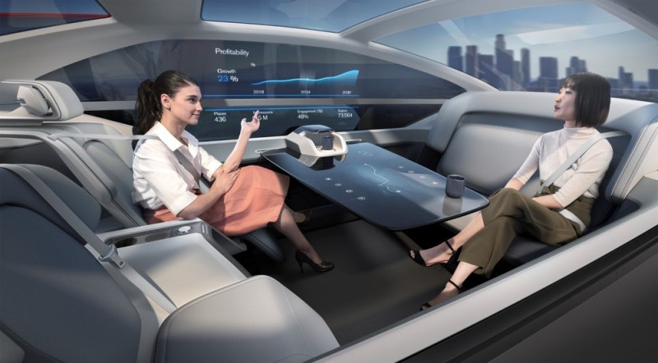
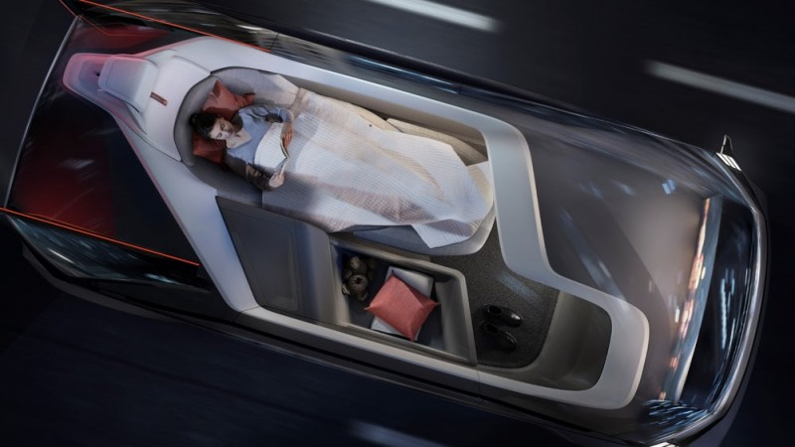
Volvo 360c
Autonomous Concept

Slide 35
Autonomous Vehicle Desirable Outcomes
Cars will last longer – Estimated 5x longer due to less moving parts.
Drive down costs – Level 5 automation / shared mobility will drastically reduce costs.
Time – 14% of people’s daily attention is currently spent on driving.
Environmental – Autonomous, shared mobility will reduce asphalt parking lots by 30%.
Safety – 40,000 reported traffic-related deaths in 2016.

Slide 36
3 Take-Aways / Desirable
Making a desirable product is not necessarily making it “look pretty”. But elegantly designed products increase users’ desire to use it.
When a product is desirable, it feels intuitive and effortless. Desirability is like “passive magic”, which keeps users coming back.
Users perceive pleasing products as more usable.

Slide 37
Applications
Notes:
Putting these

Slide 39
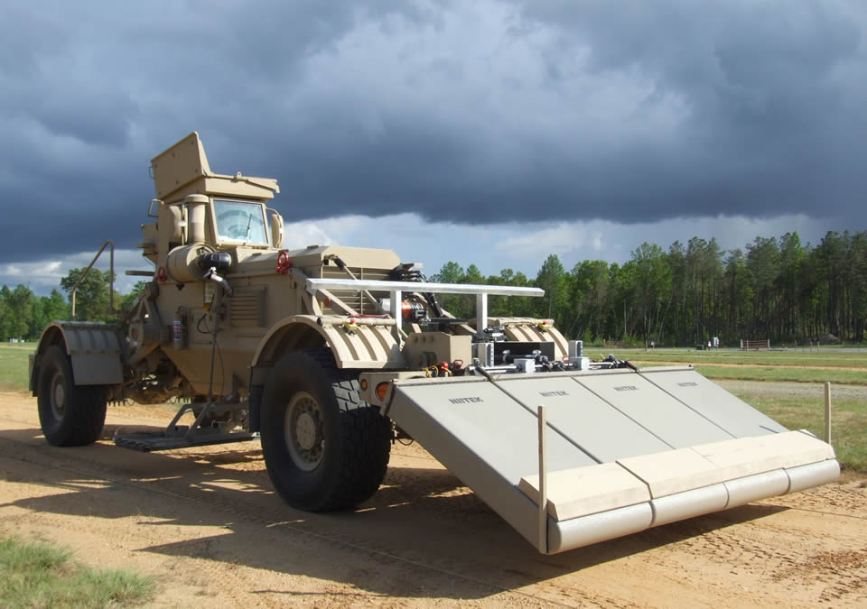
NIITEK HMDS

Slide 40
Empathize

Slide 41
Define

Slide 42
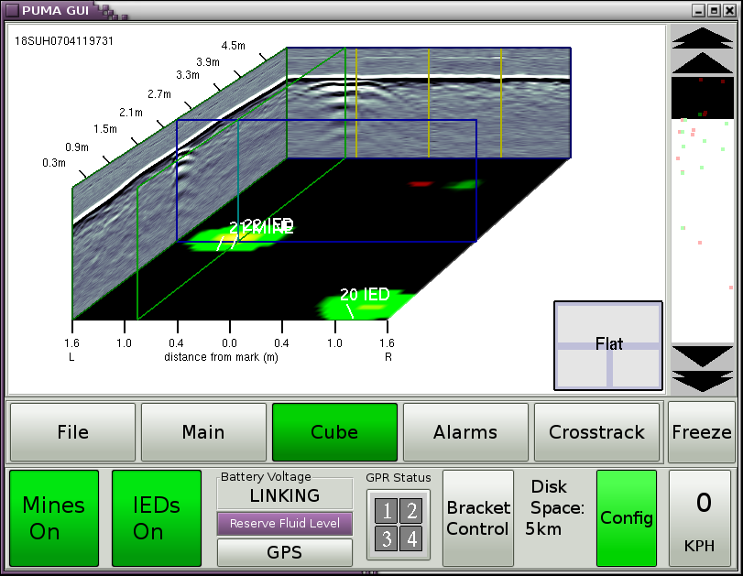
Define
Notes:
Mismatch between system / user goals
Too many buttons
Sunlight washout
Confusing hierarchy
Lack of critical info at the point of need

Slide 43
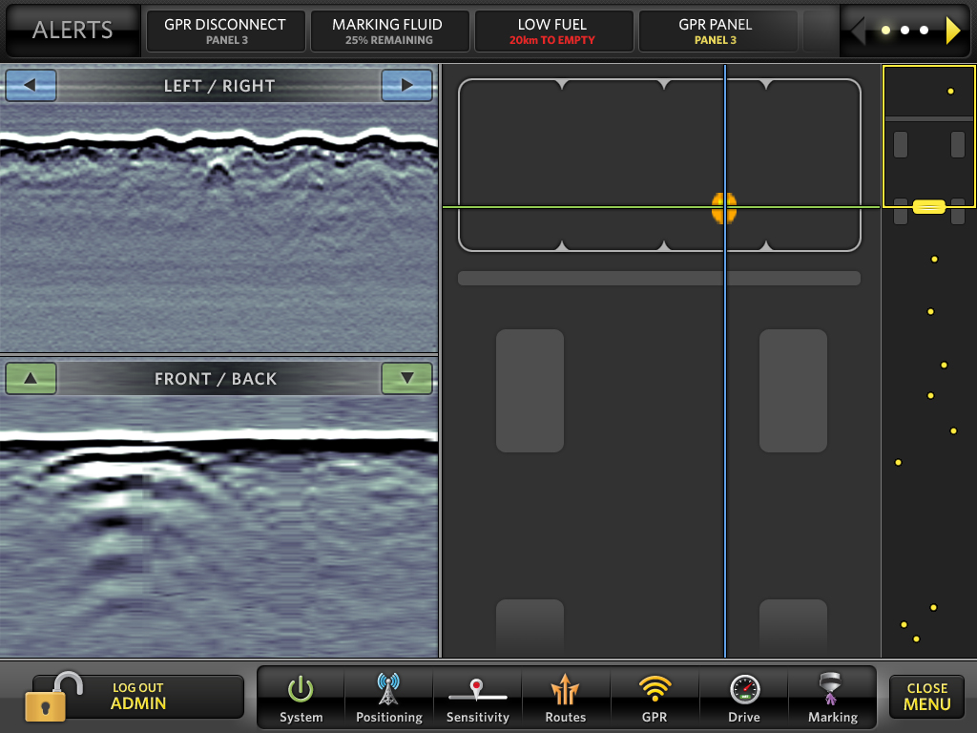
Ideate
(Design)
Notes:
Goal Directed Design
Reduced Choices
Sunlight Readable
Logical Hierarchy
Critical Info at the Point of Need
Improved Efficiency

Slide 44
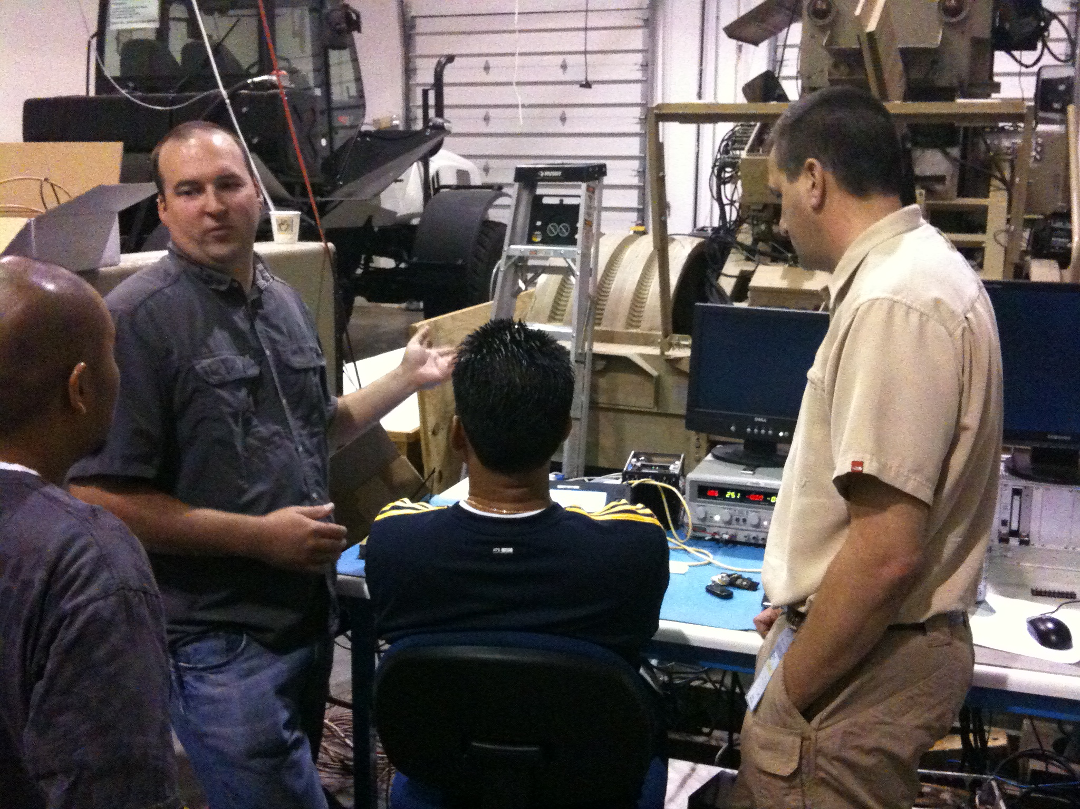
Prototype & Test

Slide 45
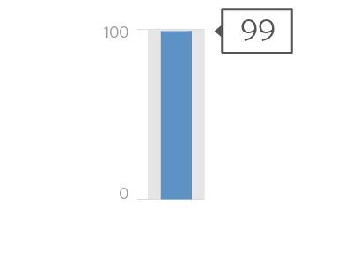
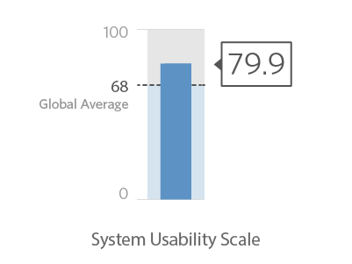
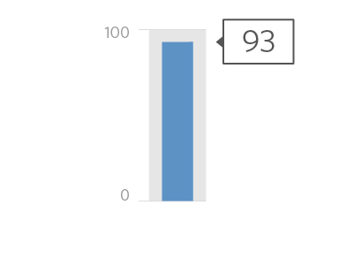
Evaluate Results
Useful
Usable
Desirable
99% of the soldiers believed that the new system enhanced their ability to perform missions.
The usability score is 12% higher than the global average.
93% of the soldiers that tried the new system wanted to deploy with it.
Notes:
TEMPLATE NOTES: Content Slide (example 1)

Slide 46
Concluding Thoughts
Useful + Useable + Desirable = Reduced Complexity
Reduced Complexity = Increased Product Use
Increased Product Use = Increased Market Share
Notes:
A product must be useful if it is to be used. If it achieves no purpose it has no point and that means it is never going to be successful. A product should be usable to increase the chances of use – the more usable a product is, the more enjoyable it will be and the easier it will be to persuade others to use it. However, neither usability nor usefulness guarantees that a design will be used. There are other considerations outside of usability and usefulness that will impact the market adoption of a product.

Slide 47
Product success begins with reducing complexity.
And reducing complexity is up to us!

Slide 48
Thank You
CREATE A MEANINGFUL EXPERIENCE
Connect;
andy@vlgux.com
www.vlgux.com

